Slide 1


How to work with Moodle?
Video Tutorial

Slide 2

What is Moodle?

Slide 3

Finding your way around platform

Slide 4
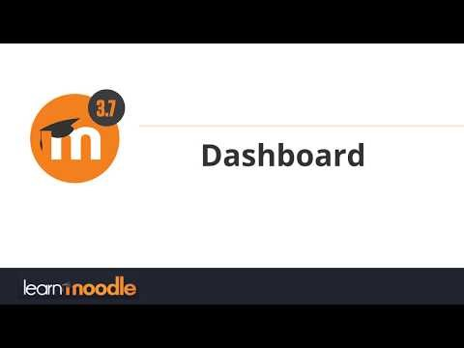
Dashboard

Slide 5
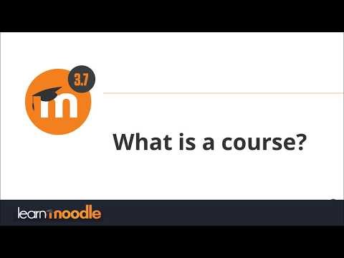
What is a course?

Slide 6
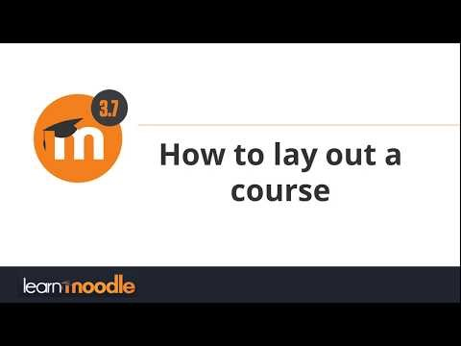
Course Layout

Slide 7
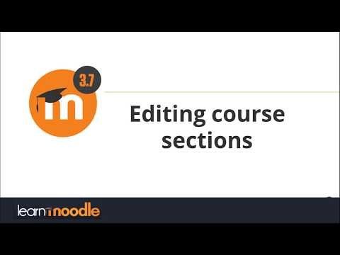
Edit Course Sections

Slide 8
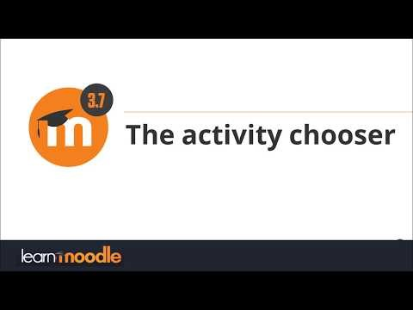
Activity chooser

Slide 9

Page

Slide 10

Book

Slide 11
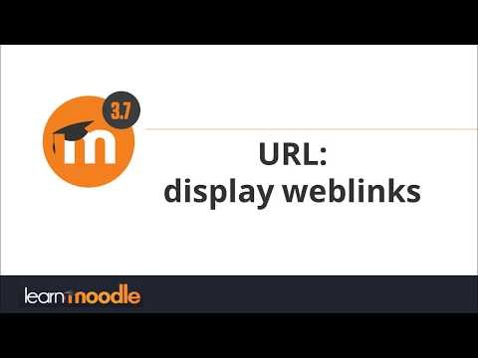
URL

Slide 12
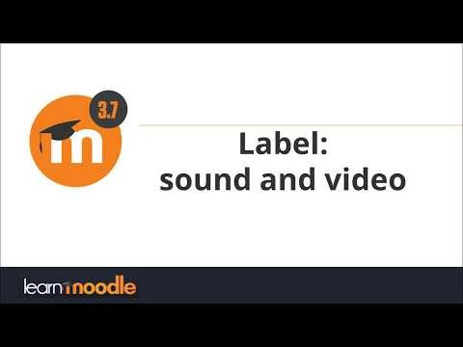
Label

Slide 13
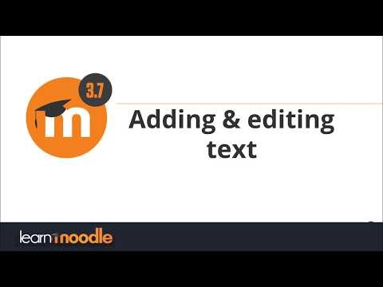
Adding and Editing Text

Slide 14
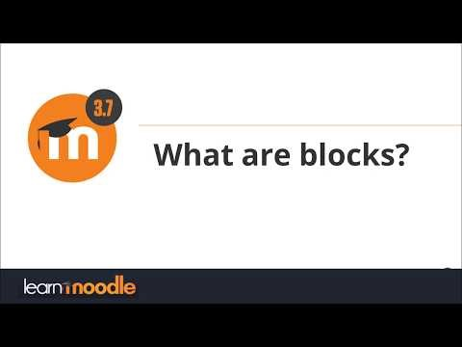
Blocks

Slide 15
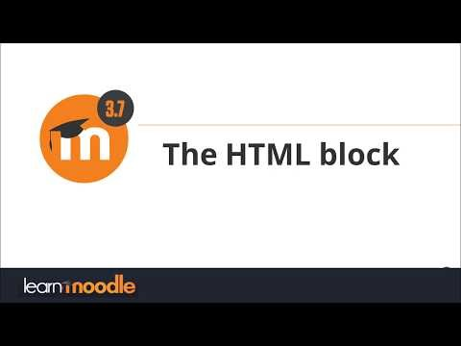
HTML block

Slide 16
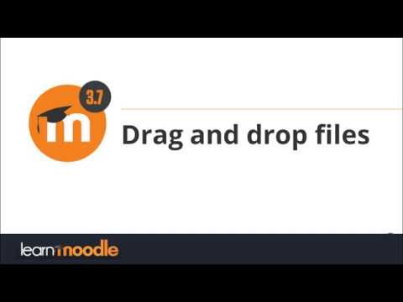
Drag and drop files

Slide 17
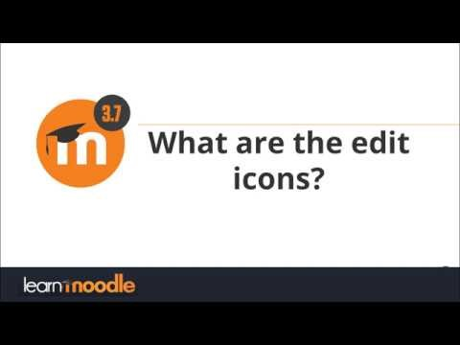
Editing icons

Slide 18
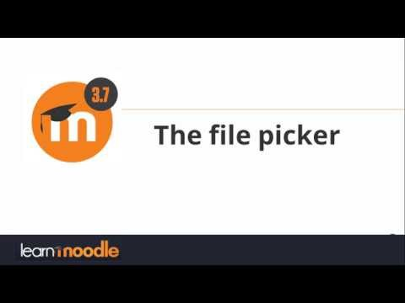
File picker

Slide 19

Private files

Slide 20
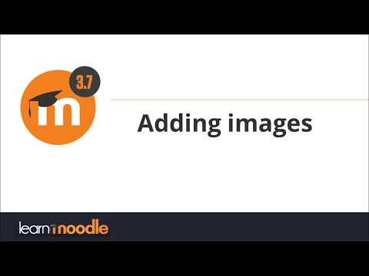
Adding images

Slide 21
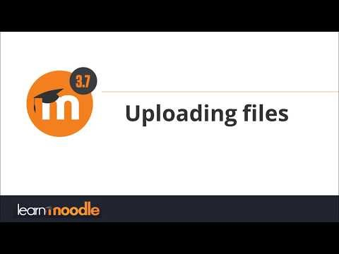
Uploading files

Slide 22
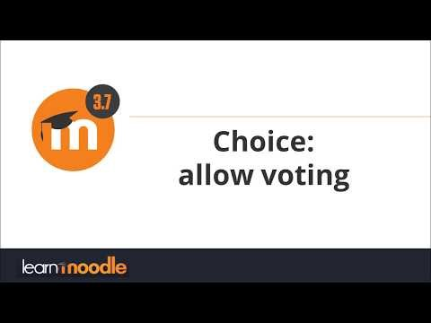
Choice

Slide 23

Glossary

Slide 24
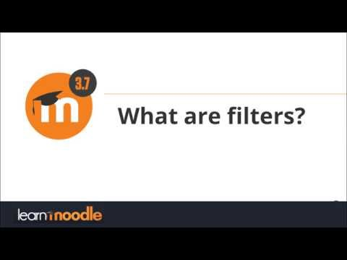
Filters

Slide 25

Forum

Slide 26
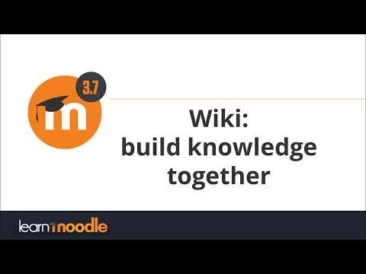
Wiki

Slide 27
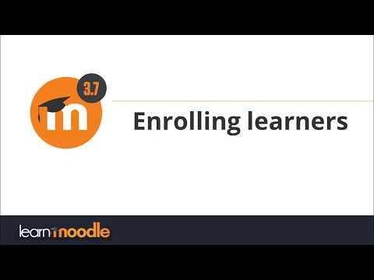
Enrolling learners

Slide 28
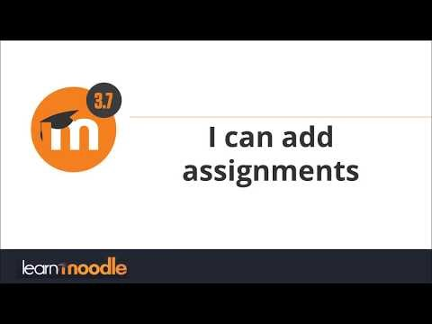
Assignment

Slide 29
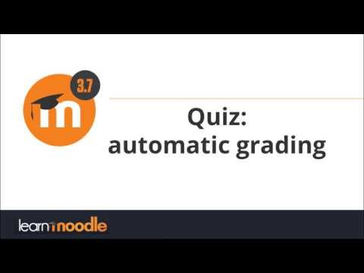
Quiz

Slide 30
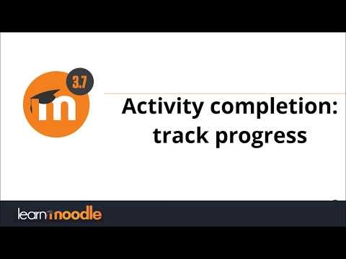
Activity completion

Slide 31
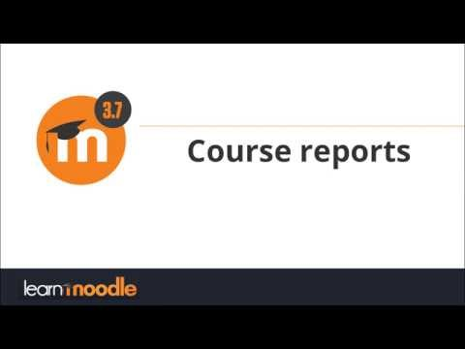
Course reports

Slide 32
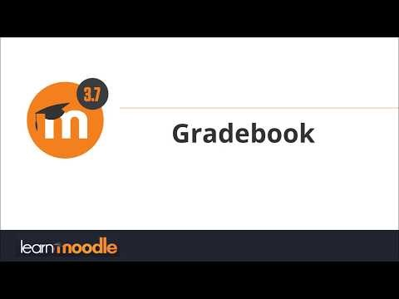
Gradebook

Slide 33
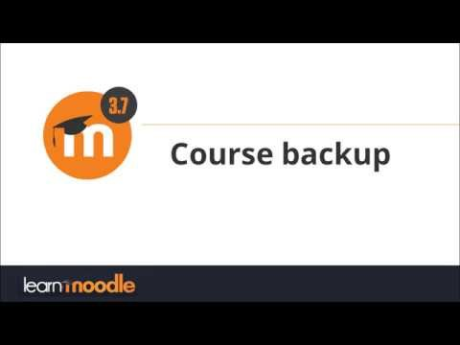
Course backup

Slide 34
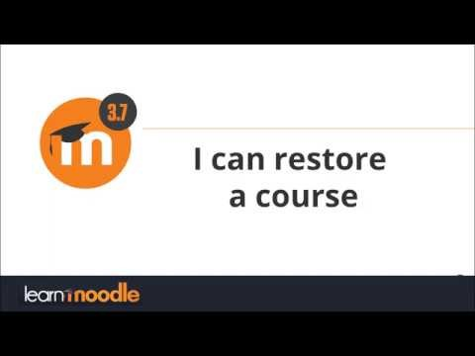
Course restore

