Slide 1


FINLIT Platform Functionalities
Webinar for key trainers
Presentation: Elka Zlateva, Emil Stoyanov
Hosting: Katarzyna Morawska
July 13, 2020

Slide 2
Financial literacy through public libraries
Co-funded by the Erasmus+ Programme of the European Union
Agreement No 2018-1-PL01-KA204-050839

Slide 3
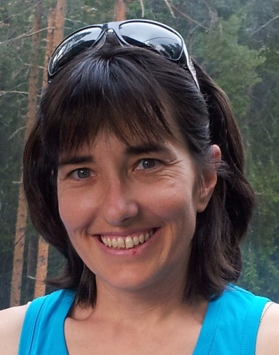
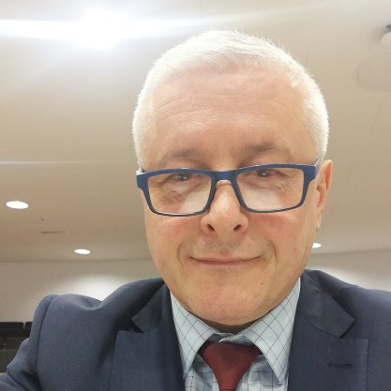
Elka Zlateva
holds PhD in Political science from Sofia University. She is FINLIT coordinator for Bulgaria.
Mrs. Zlateva has expertise in research-based analyses in the areas of education and policy development. She is experienced lector and trainer, discussion moderator and workshop facilitator author of educational resources, toolkits, analyses, online courses. She is also working as educational expert within the center for excellence at the Bulgarian Academy of Science. Mrs. Zlateva has significant experience in project management, evaluation and monitoring on local and international level.
Emil Stoyanov
holds a M. SC degree in Mathematics and Mechanics from the Faculty of Mathematics and Informatics, Sofia University St. Kliment Ochridski.
He is Founding partner and CTO of Tetracom Interactive Solutions LTD, Sofia, Bulgaria, GM of Atlas Software Ltd, Sofia, Bulgaria
Member of the Center for Educational Initiatives Association, Sofia, Bulgaria

Slide 4
In this presentation
FINLIT learning management system (LMS)
FINLIT platform structure, roles, content
FINLIT training of trainers

Slide 5
FINLIT learning management system
LMS, extensions, requirements

Slide 6

FINLIT project is about e-learning
“Blended education, also known as hybrid learning, combines classroom and online education. In other words, this methodology integrates online with traditional face-to-face teaching activities in a planned, pedagogically valuable manner.
Significant parts of this process are computer-mediated activities. These activities will be developed and integrated into the main project outcome - open source educational platform, based on MOODLE.”

Slide 7
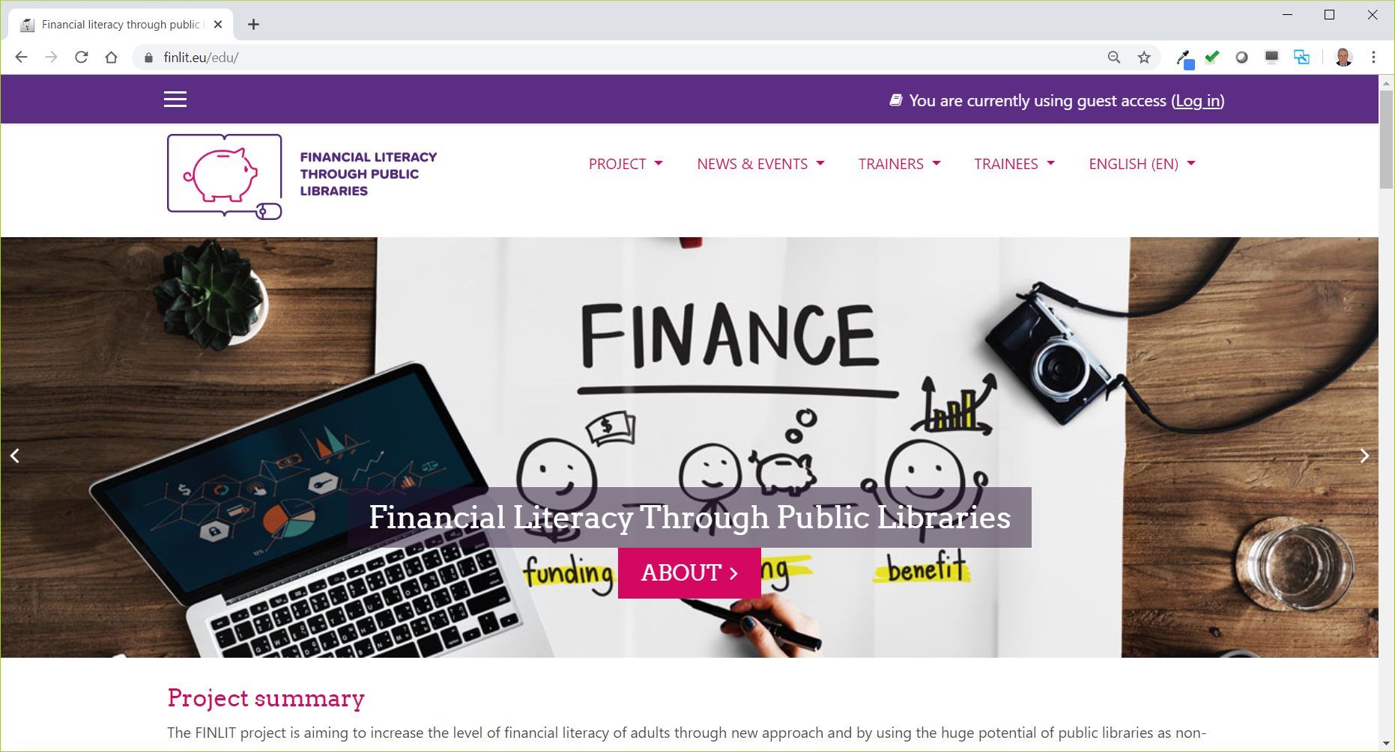
FINLIT learning environment

Slide 8
Multilingual platform
Bulgarian
Romanian
Slovenian
Polish
English

Slide 9
Learning Management System - LMS
Learning management system (LMS) is a software
application that is used to deliver online training.
It allows to quickly create courses, enroll users easily and
accurately report on learner progress.

Slide 10




Purpose of the LMS
LMS delivers and manages all types of content, including video, courses, and documents. It is used both in education and higher education markets, but is business too. “The time has come when you need to make a decision and find out not if but what kind of LMS would be the best option for your business.” ten the use E-learning industry, 2020of a syllabus.

Slide 11
Advantages of LMS
Saves time - the instructors can utilize that time to focus more on each individual’s progress;
Saves money - everything becomes digital, no need of notebooks, copies, etc.;
Gives freedom to the user to learn from anywhere and increases mobility;
Interesting - video tutorials, clips, gamification, etc.;
Quick and accurate;

Slide 12
Disadvantages of LMS
The impact of face-to-face interaction is reduced, as no gathering is required for learning;
It increases the tunnel effect of learning, hence the scope of wide thinking may get reduced and the user may just see through LMS, thereby leaving many opportunities outside;
Some students need motivation and encouragement to learn which will be missing and thereby credibility issues will be present;
Technical equipment required;

Slide 13

Distance and blended learning
The challenge of COVID-19

Slide 14
FINLIT Learning Platform is based on Moodle
Why?
Covers all project requirements
Attractive visual design
Everything is done in one place – project web site & learning platform
Offers attractive learning experience with the Interactive content and Webinar modules
No1 Open-Source Learning Management System
Large community of users, good support
Highly secure, highly extendable
Strong community support
Mobile App for users with Smartphones and Tablets

Slide 15


FINLIT - Moodle+
FINLIT platform has some important extensions:
Project information section
News and events section
H5P Interactive Content
BigBlueButton Webinar

Slide 16

FINLIT Learning Platform Extensions
H5P Interactive Content
  Interactive Videos
  Presentations
  Games
  Tests and Quizzes
  … and many more

Slide 17
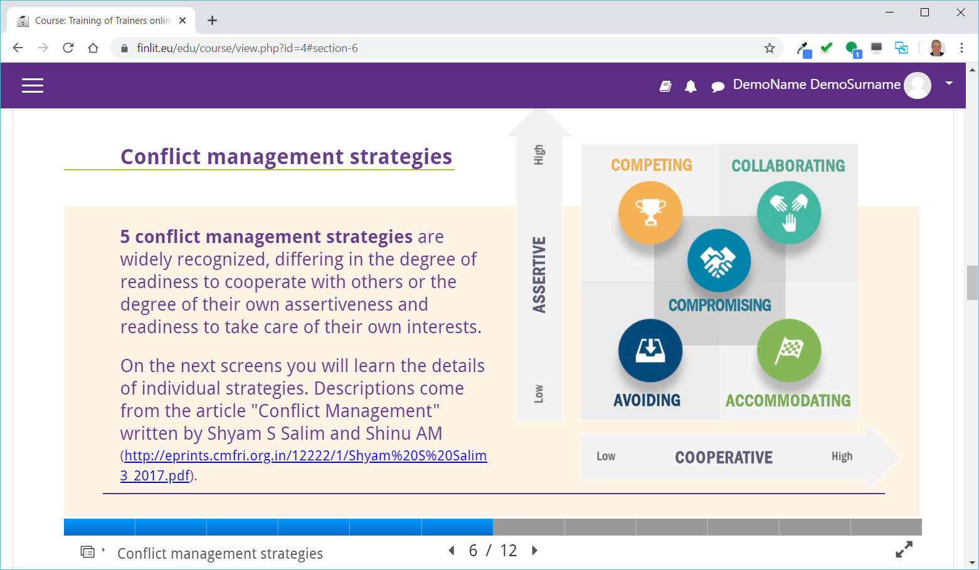
FINLIT Learning Platform Extensions – examples

Slide 18
FINLIT Learning Platform Extensions
BigBlueButton Webinar
Supports real-time sharing of presentations (including whiteboard), audio, video, chat and screen;
All content can be recorded for later playback;
Create multiple Webinar sessions within any course;
Restrict trainees from joining a session until a trainer (moderator) joins the session;
Launch Webinar Session in a separate window;
Schedule a Webinar - specify join open/close dates and hours for the session that appears in the platform's calendar;
Record a session;
Access, manage and display recordings within course

Slide 19
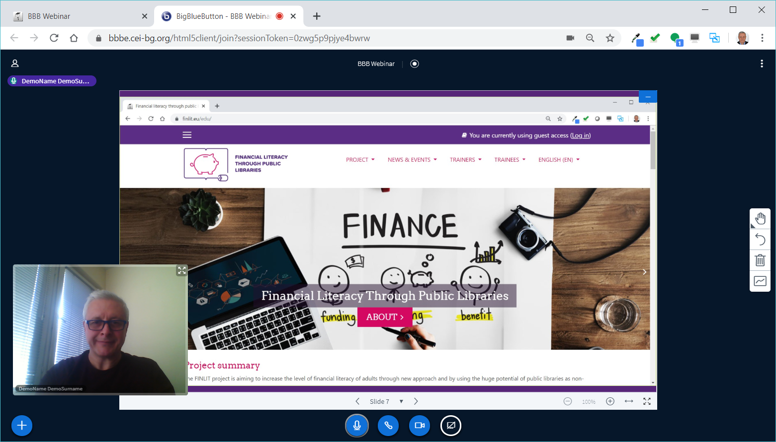
FINLIT Learning Platform Extensions - BigBlueButton Webinars

Slide 20
FINLIT offers different types of e-learning
Synchronous training
Real time interaction of participants with an instructor via BigBlueButton
Asynchronous training
No live interaction of participant with the instructor – online course

Slide 21
FINLIT structure and roles web site structure, user roles, how to organize webinars

Slide 22
FINLIT Web Site Structure
PROJECT
  Summary, Partners, Outcomes, Contacts
  NEWS & EVENTS
  News, News gallery, Calendar
TRAINERS
  Online course, Webinars, Onsite course, Resources
TRAINEES
  User guide, Basic modules (6), Advanced modules (6)

Slide 23
FINLIT - User roles 1/4
FINLIT Learning environment users can have the following roles:
Administrators
Country Administrators
Key trainers & Assistant trainers
Librarians – adult trainers
Trainees – adult users
Each user can have several roles.

Slide 24
FINLIT - User roles 2/4
Administrators
They access and manage all platform features and aspects including textual content, pages, courses, webinars, users, configurations
Country administrators
They create online courses in their country language, update course content, enroll users - trainers and trainees in a course, schedule webinars, access student performance and course statistics

Slide 25
FINLIT - User roles 3/4
Key trainers & Assistant trainers
They enroll trainees to their course, create and schedule Webinars, conduct webinars as moderators, access trainees performance and course statistics
Librarians – adult trainers
They can access the platform, log in, enroll in a course, access course content, take tests and quizzes, participate in webinars

Slide 26
FINLIT - User roles 4/4
Trainees – adult users
They can access the platform, log in, enroll in a course, access course content, take tests and quizzes, participate in webinars
Guests/Visitors
They can access the platform but do not log in, enroll in financial courses, see the news&events, read project info, visit partners pages

Slide 27
BigBlueButton Webinar
How to organize webinars?
A short online demonstration will show how to create and organize a webinar or online learning session within the platform.
A recorded video will be made available here afterwards.

Slide 28
FINLIT Learning content
Training programs for librarians as adult trainers
Training program on financial literacy for adult users

Slide 29
FINLIT Learning content
FINLIT Learning content consists of courses, each course consist of modules.
In order to access learning content in your language you will be either enrolled by your Country administrator or by your Trainer.
User can also enroll in and take a course simply by accessing it if self enrolment is enabled for this course.

Slide 30
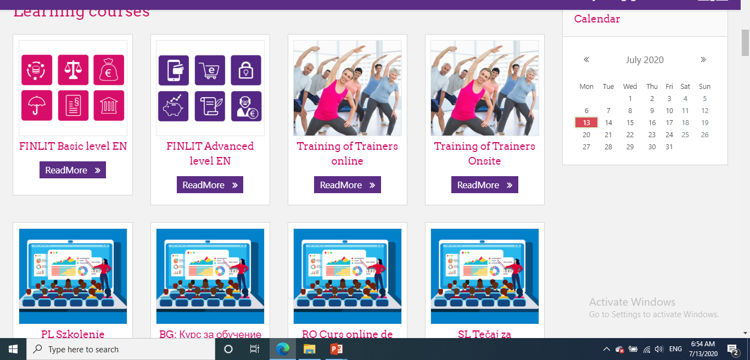

Slide 31
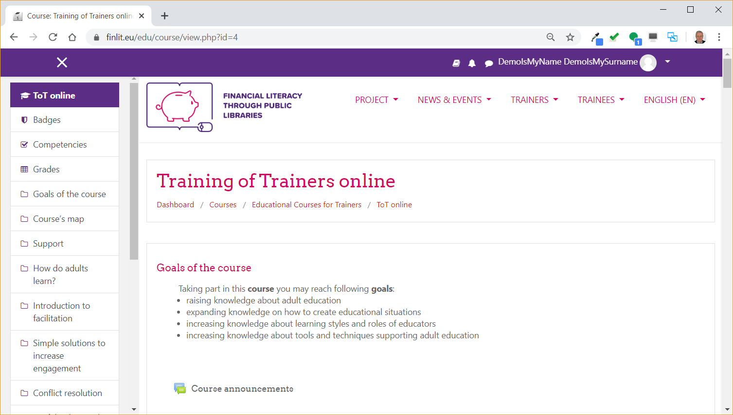
Explore course content, scroll down the page

Slide 32
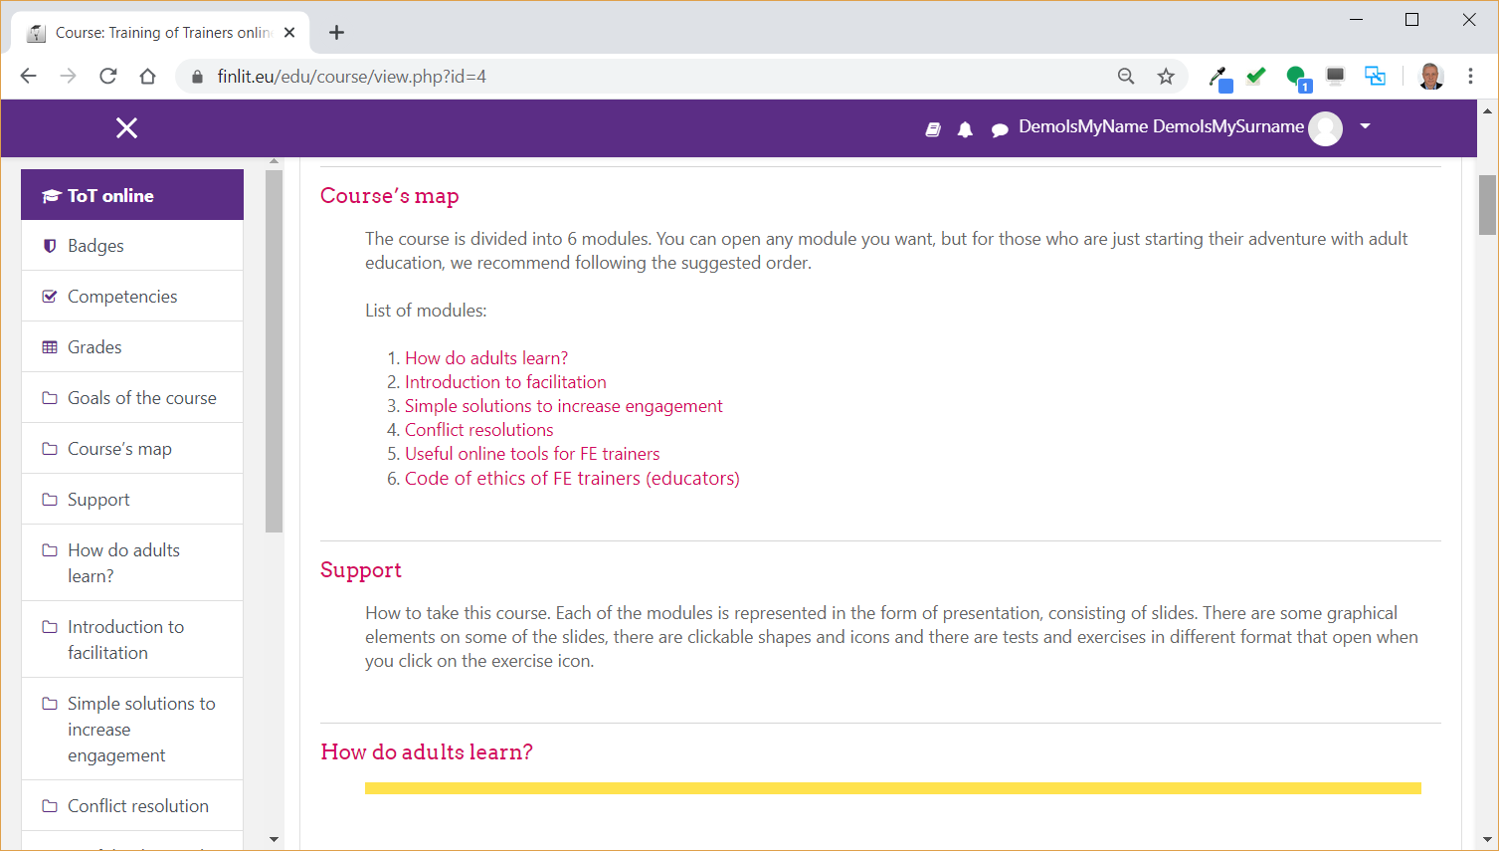
Explore course content

Slide 33
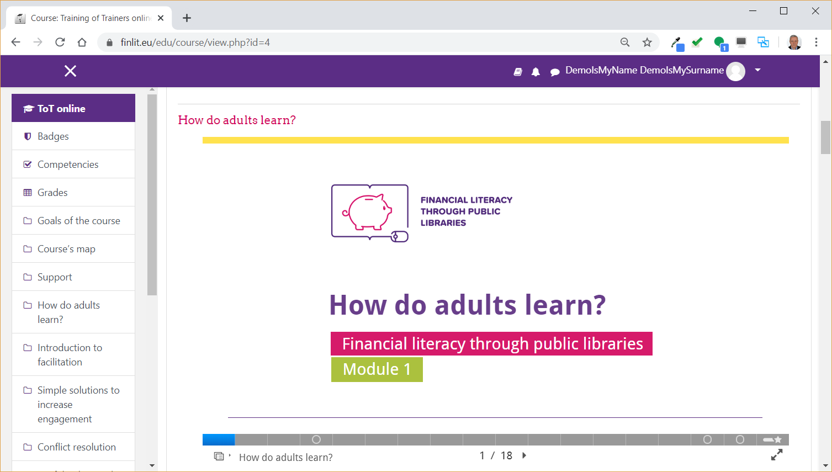
Read course content slide by slide, module by module

Slide 34
ToT Course structure
Course map
List of modules:
How do adults learn?
    Introduction to facilitation
    Simple solutions to increase engagement
    Conflict resolutions
    Useful online tools for FE trainers
    Code of ethics of FE trainers (educators)
Assessment test

Slide 35



^{CERTIFICATE OF}
^{COMPLETION}
^{To certify that}
^{Name Surname}
has successfully completed the online course for adults training in public libraries within the project “Financial literacy in public libraries”.
^{Day/Month/Year}
^{Certificate number}

Slide 36

Open up the browser and visit FINLIT web site address:
https://finlit.eu
Explore course content ☺
EXERCISE

Slide 37
FINLIT Training of trainers how to train librarians

Slide 38
Practical steps
schedule a training session;
Invite participants;
form groups;
get them registered on the platform;
assign them to the course - BG/RO/PL/SLO;

Slide 39
Create a learning path – variant
  plan face-to face training;
  prepare agenda;
  ask them watch webinar 1 and 2 before the first meeting;
  conduct first meeting and present the agenda;
  give them time to make the online course alone or part of it;
  ask them watch webinar 3 and 4 before the first meeting;
  gather together for onsite training, print certificates and celebrate ☺

Slide 40
Online training via the platform
  The following workflow should be put in to place in order to conduct online training via FINLIT LMS platform:
  Country administrator registers trainees as users in the platform with their emails, generates passwords and issues notification emails for the registration.
  Key trainer enrolls trainees to - either Basic or Advanced level – course, separates them in to groups and assigns Librarian and Assistant trainers for each of the groups.
  Key trainer creates and schedules Virtual classroom training sessions in the course for each of the trainee groups. Usually there should be an introductory session, at least one learning session per course module (6), and one closing session with verbal instructions for taking the assessment test and final discussion.
  Librarian and Assistant trainers follow the online learning sessions schedule and conduct the learning process until the final session.

Slide 41
Communication with librarians
  Communication in the platform can occur in several communication channels as follows:
  Each of the courses has a discussion forum accessible on the top of the course where trainers and users can post messages, questions and answers.
  Trainers can send email messages to the trainees en masse in order to notify them for important developments, forthcoming learning sessions, etc.
  Trainers can record video and audio messages within the course that can be watched and listened by the trainees.
  Within the LMS platform there is a Virtual Classroom (BigBlueButton) where online face-to-face learning sessions can be conducted with engaged camera and microphone for each of the participants. The sessions can be recorded and made accessible for preview later on.

Slide 42
Monitoring the progress of the Trainees and statistics
  Key, Librarian and Assistant trainers have access and can monitor Trainee progress within the course, including the module learning progress, results from the quizzes available in modules and final assessment test.
  Detailed statistics is also available within the platform.

Slide 43


Slide 44
This webinar was prepared within the Financial literacy through public libraries project, co-funded by the Erasmus+ Programme of the European Union, Agreement No 2018-1-PL01-KA204-050839
FINLIT – Bulgaria team

Slide 45

https://finlit.eu
Goodbye

